Slide 1
INSTRUMENT CLUSTER DESIGN
Ottawa Infotainment
UI/UX Innovation Challenge
Performance-Driven Dashboard Interface
Team InF1nite | Ottawa Infotainment Inc.
[Shaurya, Shrinicketh, Reshma, Timothy, Harinath, and Krishna] — UI/UX Design & HMI Engineering
Challenge Track: Instrument Cluster Design
Feb 18, 2026

Slide 2
1. Problem Statement
A High Net Worth Individual (HNWI) who owns an automotive company.
He is purchasing this sports car as a career milestone.
He also wants to impress his teenage kids, making the car's technology feel aspirational and exciting to a younger, tech-savvy generation.
The User
The Problem
Why It Matters
This user has an exceptionally high bar. As someone who runs an automotive business, he understands vehicles deeply, generic dashboards won't impress him.
His teenagers, raised on smartphones and gaming, will judge the interface instantly.
The current instrument cluster is forgettable i.e. it lacks emotional impact and fails to communicate performance character
The dashboard is the first thing driver and passengers react to on entry
A milestone purchase demands a UI worthy of the occasion
Dual audience (expert professional + tech-savvy teens) demands sophistication and excitement
At 195 mph, poor information design is dangerous as a 2 sec glance means 572 ft travelled blind
Notes:
Delete the user

Slide 3
2. User & Context
Primary User Persona
Key Constraints
Male, 65 years old, HNWI, owns and operates an automotive company
Safety
Deep knowledge of cars as he will notice every design decision
1.5-second glance threshold is non-negotiable
Purchasing this as a personal career milestone so the emotional significance is very high
Sophistication
must feel as premium as the price tag with good animations
Wants to feel proud showing this car to his family, especially his teenage children
Dual appeal
exciting for teens, refined and purposeful for an industry expert
Hardware
Dual screen display, 1920×720, 60 fps
Secondary Audience (Influential)
Teenage kids, highly tech-literate, expect smooth smartphone and gaming UX
They reaction matters deeply to the father
Notes:
Check for the constraints

Slide 4
3. Existing Solutions & Gaps
Current Benchmarks
What Works Well
Critical Gaps — Our Opportunity
Porsche / McLaren — refined and technical
European premium brands: consistent, polished, brand-coherent visual language
No system targets the dual audience: Data centric design for drivers + appeasing to the passengers
Ferrari digital cluster — prestigious but complex
Tesla/Rivian: immediately impressive startup animation, familiar to younger users
Startup and ambient animations are absent or forgettable
Corvette / Mustang digital — bold and American but aesthetically rough
Sports-focused systems: performance data density that experts appreciate
Tesla / Rivian — clean and modern but not performance-oriented, no sports car character
This is where we differentiate

Slide 5
4. Proposed Solution – Concept Overview
Our Solution
A performance-driven digital instrument cluster that feels like a career milestone every time the car starts while striking enough to earn a teenager's respect, sophisticated enough to satisfy an automotive industry expert and safe enough to use at higher speeds.
Key Differentiators
Cinematic startup sequence
Three-tier visual hierarchy
1
Creates emotional impact from the first moment
2
Ensures information clarity at a glance
Three adaptive modes
Normal/Street (refined, premium), Sports
(necessary data-first) and Night mode
Design language
3
4
Bold, precise, confident Detroit character
Ambient display states
5
Make passengers feel they're in something genuinely special

Slide 6
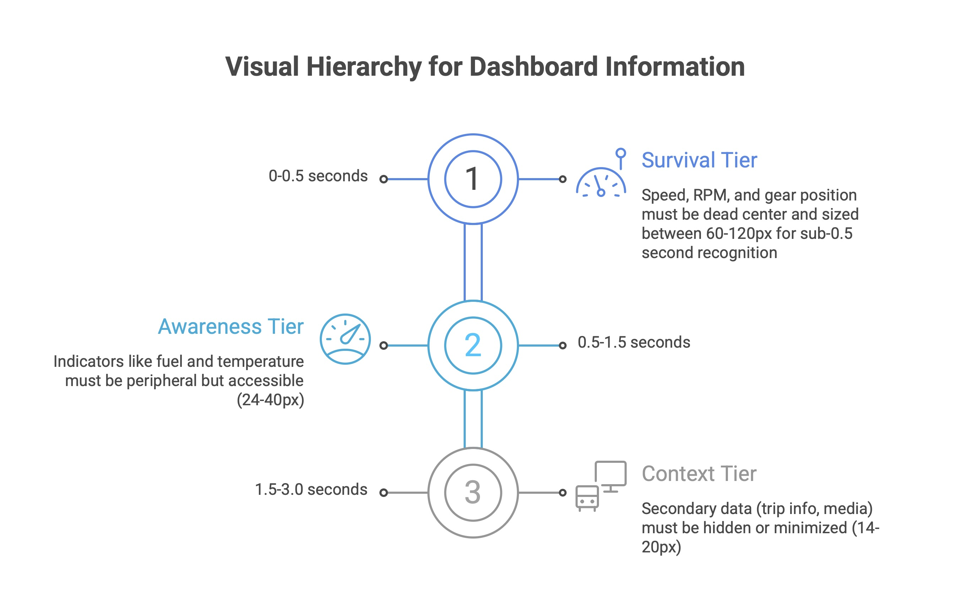

Slide 7
5. User Flow & Interaction
Startup Flow
Warning Alert Flow
Driver enters → key press → cinematic startup sweep → Street mode fades in → Dashboard settles into clean premium resting state
Critical (brake failure, engine fire)
Full-screen red takeover + audible alarm — no dismiss
Urgent (low oil, door ajar)
Mode Switch Flow
Persistent amber icon + text until resolved
Single steering wheel button press → Smart Animate transition (300ms) →
Advisory (service due)
Sport: RPM dominates, G-force meter appears, color accent intensifies
Shows once, collapses to small icon only
Normal: balanced layout — Speed prominent, navigation and fuel accessible, refined ambient glow
Spatial Consistency Rule
Speed, RPM, and Gear never move across any mode, muscle memory that holds at 150 mph
Notes:
User interaction diagram

Slide 8
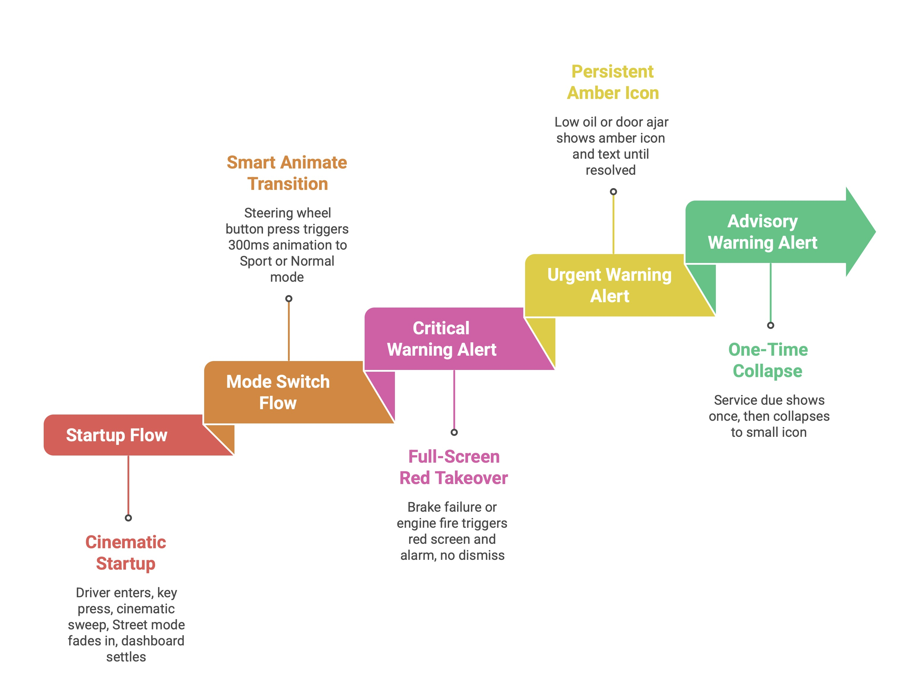
Notes:
Title

Slide 9
6. Prototype / Visual Design
Figma Prototype 1
Completed
Three-Tier Visual Hierarchy
Feb 2–6
Street mode: Speed center (large hybrid digital/analog), RPM arc left, Fuel/Temp/Nav flanking
1
Tier 1 — Critical Driving Info
Speed, RPM, Gear — Always visible, never moves
Dark background, white primary text, red accent for redline and warnings
Typography: Bold and clearly distinct
2
Tier 2 — Secondary Data
Cinematic startup
Fuel, Temp, Navigation — Contextually relevant
Figma Prototype 2
In Progress
3
Tier 3 — Ambient & Aesthetic
Feb 9–20
Animations, glow effects, brand moments — Passenger-facing
Full component library: Warning (Inactive/Active/Critical), Gear (P/R/N/D/1–7), Mode Badge (Street/Sport), Fuel (Full/Half/Low/Critical)
Smart Animate transitions across all three modes
Auto Layout status bar — warning icons reflow as alerts appear/clear
Ambient glow animations designed for passenger-facing first impression

Slide 10
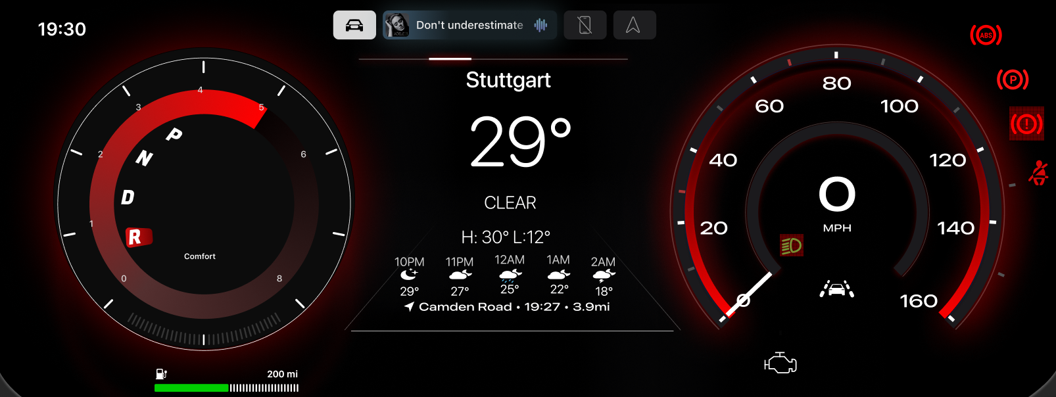
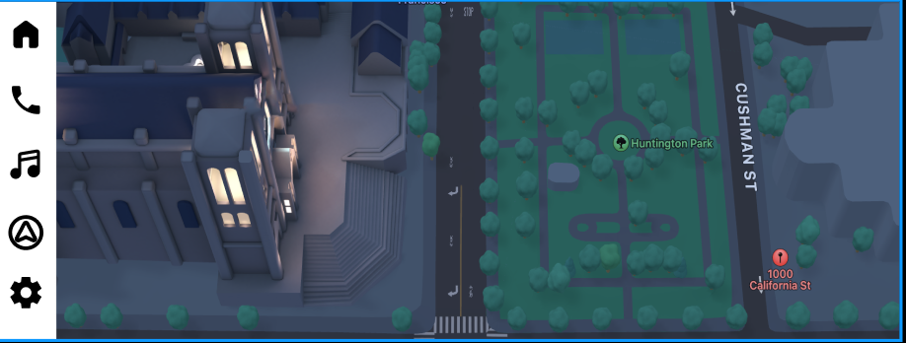
Notes:
One image per slide, and mention as Detroit.

Slide 11
7. Technology & Implementation
Design & Prototyping Stack
State Machine Architecture
Figma
Mode states
Component library, Smart Animate, Auto Layout, full variant system
Normal/Street ↔ Sport (single steering wheel button, no menus)
Alert states
Normal → Advisory → Urgent → Critical (escalating override)
Implementation Stack
Startup state
GL Studio 7.x+
automotive HMI implementation platform
Cinematic sequence → Street default
Notes:
Hardware assumption

Slide 12
8. Validation & Evaluation Plan
The Glance Test
Dual Audience Validation
(Primary Safety Validation)
Show dashboard for 1 second, hide it, ask: "What speed? What gear? Any warnings?"
HNWI expert test
Does it feel worthy of an automotive professional? Sophisticated, not gimmicky?
Any failure triggers a redesign.
Teen impression test
Key Usability & Safety Metrics
First reaction to startup and Sport/Street modes
Primary info (Speed, RPM, Gear)
< 0.5s
Secondary info (Fuel, Temp, Nav)
< 1.0s
All interactions (NHTSA threshold)
< 1.5s
GL Studio rendering
60fps
Critical warning comprehension
< 0.5s
Mode switch
< 400ms
Notes:
Mention the paper data in this slide

Slide 13
9. Progress & Roadmap
COMPLETED
Phase 1: Figma Prototype 1 (Feb 2–6)
Street and Sports mode dashboard
Component library foundation, project documentation (PRD, Design Brief, Tech Specs)
IN PROGRESS
Phase 2: GL Studio + Prototype 2 (Feb 9–20)
GL Studio installation, tutorials, component architecture exploration
Figma Prototype 2: Startup animations, Day and night modes added
Full variant system built
SVG assets exported for GL Studio
REMAINING
Phase 3: GL Studio Implementation (Feb 21 – Mar 4)
Core implementation: gauges, state machine, startup animation, CAN simulation
60fps optimization, glance testing under adverse conditions
Final polish, demo setup, rehearsal for presentation

Slide 14
10. Risks & Limitations
Technical Risks
UX & Safety Concerns
60fps on ARM hardware
Startup animation as distraction
Figma to GL Studio translation
Solution: plays on ignition only, not mode switches
Mode switching disorientation
Solution: Tier 1 elements never change position across modes
Assumptions & Scope Limitations
Teen-appeal features vs. safety hierarchy
Solution: ambient effects are always Tier 3
Glance testing is informal, not clinical

Slide 15
11. Summary & Ask
Value Proposition
Feedback We're Seeking from Judges
An infotainment system that makes it worthy of a career milestone, impressive enough to earn a teenager's interest, sophisticated enough to satisfy an automotive industry expert, and safe enough to use at full speed.
1
Does our dual-audience framing (driver + passengers) feel like a genuine differentiator?
2
Is the cinematic startup sequence an asset or a distraction risk — where is the line?
Key Takeaways
1
Every pixel is justified against the 1.5-second glance rule
2
Dual audience design: refined premium character for the driver, visual excitement for passengers
3
What would make the most impact for the Final demonstration?
3
Production-ready pipeline: Figma → SVG → GL Studio → DragonFire Pro

Slide 16
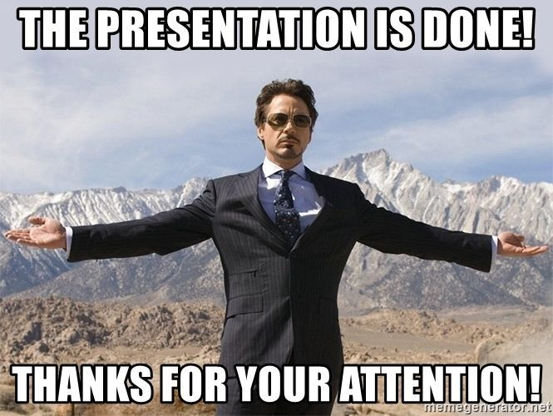
Thanks!
Team InF1nite | Ottawa Infotainment Inc.

